Slide 1
Data analysis of gurujiastro case study
By Ishan Sarkar

Slide 2
Introduction
About Me
Name: Ishan
Career Aspiration: Aspiring Data Analyst
Education
Current Course: Data Science and Machine Learning
Institution: Scaler
Enrolment Date: July 2023
Professional Experience
Internship:
Role: Data Analyst
Company: KultureHire
Work Experience:
Industry: Non-Tech
Duration: 5 years
I am dedicated to transitioning into a data-driven career, leveraging my extensive experience and recent education to excel in the field of data analysis.

Slide 3
Understanding Non-Numerical Columns
Shape: There are 28047 rows and 45 columns
_id: Each record has a unique identifier (_id), ensuring that there are no duplicates in the dataset.
user: There are 10344 unique users, with the most frequent user appearing 158 times. This indicates some users have multiple interactions.
chatStatus: There are 5 unique chat statuses, with "failed" being the most frequent (7256 times). This suggests a significant proportion of chats are not completed successfully.
guru: There are 133 unique gurus, with the top guru appearing 1580 times. This indicates that certain gurus are more active or preferred than others.
guruName: There are 151 unique guru names, with "Astro Krishaa" being the most frequent, appearing 1580 times. This suggests that some gurus are highly popular or active.
consultationType: There are 4 unique consultation types, with "Chat" being the most common (19514 times). This indicates that chat is the preferred mode of consultation.
website: There are 3 unique websites, with "gurucool" being the most frequent (20225 times). This suggests that "gurucool" is the dominant platform for these consultations.
refundStatus: There are 4 unique refund statuses, with "no-refund" being the most frequent (28022 times). This indicates that almost all transactions are non-refundable.
createdAt: Each record has a unique creation timestamp, indicating when the record was created.
updatedAt: Almost all records have unique update timestamps, suggesting frequent updates or modifications to the records.
statementEntryId: Each statement entry is unique, indicating no duplicates in financial records.
chatStartTime: Each chat start time is unique, indicating that chats are starting at different times without any overlap.

Slide 4
chatEndTime: Each record has a unique chatEndTime, indicating a wide range of chat end times with no overlaps.
callChannel and callIvrType: All records for callChannel are "Normal" and all for callIvrType are "Exotel", suggesting a uniform system setup for these attributes.
callStatus: There are 5 unique call statuses, with "completed" being the most frequent (3453 times). This indicates that a majority of calls are successfully completed.
CallSid: Each record has a unique CallSid, ensuring no duplicate call identifiers.
astrologerCallStatus: There are 4 unique astrologer call statuses, with "completed" being the most frequent (9172 times), indicating successful interactions from the astrologer's side in most cases.
region: All records have the region set to "Indian", indicating a geographical uniformity.
userCallStatus: There are 5 unique user call statuses, with "completed" being the most frequent (7621 times), indicating most users also complete their calls successfully.
RecordingUrl: Each record has a unique RecordingUrl, showing that call recordings are distinct for each interaction.
feedback: Each record has unique feedback entries, indicating personalized feedback for each interaction.
hideHistory: The majority of the records (19175) have hideHistory set to "False", suggesting that most users prefer to keep their call history visible.
cardPosition: There are 35 unique card positions, with "profile_1" being the most frequent (132 times), indicating varied card positions but with a common preference.
Remedies: There are 97 unique remedies, with the most frequent remedy ("Hello") appearing only 3 times, indicating a diverse range of remedies provided.
offer: There are 6 unique offers, with "first" being the most frequent (15887 times), suggesting that the "first" offer is highly prevalent.
refunds[0]: There are 5 unique refund entries, each appearing only once, indicating rare refund cases.
source: The majority of records (16256) come from the "Production" source, showing a dominant source of data.
complementaryCallOrganiser: Both records have the same organizer, indicating a single entity handling complementary calls.
disconnectedBy: There are 4 unique entities that can disconnect a call, with "user" being the most frequent (6 times), indicating that users are the primary disconnections initiators.

Slide 5
Understanding Numerical Columns
gid and uid: The gid values range from 8 to 325 with a mean of 220.89, suggesting a fairly uniform distribution within this range. The uid values range widely from 1 to 44005 with a mean of 34846.34 and a high standard deviation of 7812.32, indicating significant variability among user IDs.
chatSeconds: The majority of chatSeconds values are consistently 300 seconds, as indicated by the 25th, 50th, and 75th percentiles all being 300. The outliers, with a maximum of 7980 seconds, contribute to the high standard deviation.
__v: This column appears to be largely zero with a few entries set to 1, suggesting it may be a versioning or status indicator with minimal variance.
timeDuration: The timeDuration values show a skewed distribution with a mean of 1.98 and a median of 0.1, and a wide range up to 67. This indicates a large number of zero or near-zero durations, with some significantly higher durations.
amount: The amount data shows a large number of zero values, with the mean being 23.74 but the 75th percentile being 0, indicating a high skewness with a few high values (max 1800).
astrologerOnCallDuration: The astrologerOnCallDuration values also show a skewed distribution with a mean of 128.79, a median of 34, and a maximum of 4029. This suggests many short calls and a few much longer calls.
astrologersEarnings: Similar to amount, the astrologersEarnings shows a high skewness with most values at 0 (75th percentile is 0) and a few higher earnings (max 900).
netAmount: The netAmount mirrors the amount values, indicating a similar skewed distribution with most values at 0.
userOnCallDuration: The userOnCallDuration shows a similar distribution to astrologerOnCallDuration, with a mean of 118.78, median of 8, and maximum of 4020. This suggests many short user durations and some long ones.
callSeconds: With only 2 data points, the callSeconds values show extreme variability (min 6000, max 60000), making it difficult to draw conclusions without more data.

Slide 6
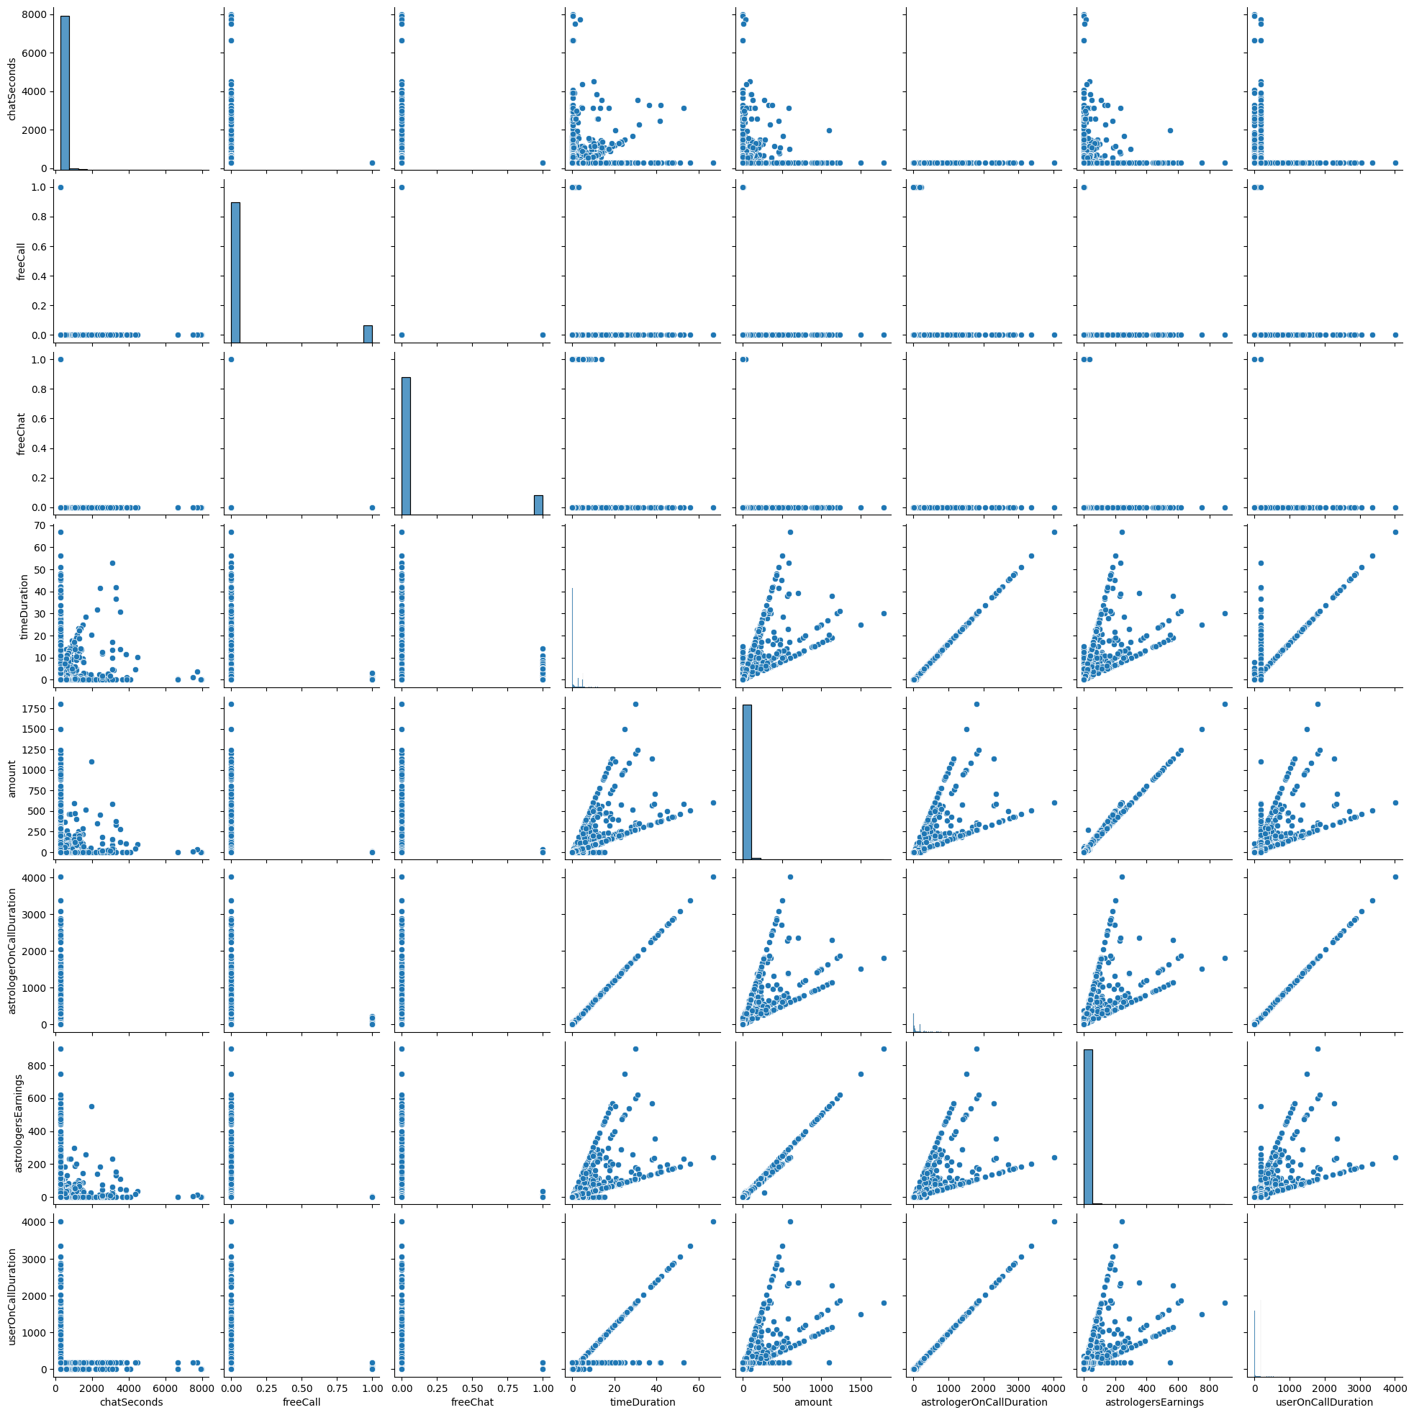
Data Exploration

Slide 7
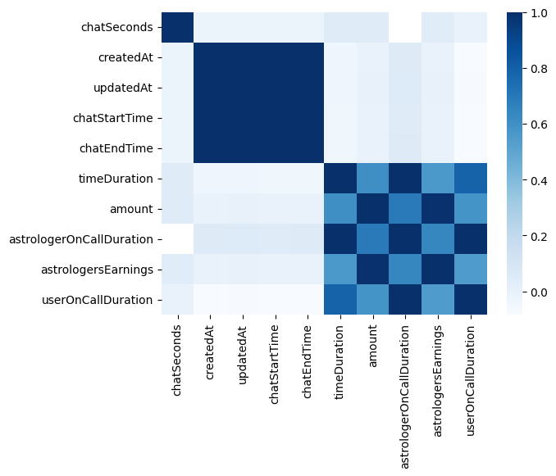
Data Exploration
Insights and Suggestions:
High Correlations:
Variables like createdAt, updatedAt, chatStartTime, and chatEndTime are highly correlated and could be redundant. Consider removing some of these variables or combining them into a single feature if they represent the same concept.
The high correlation between astrologerOnCallDuration and userOnCallDuration suggests that one of them could potentially be removed without losing much information.
Outliers and Distribution:
The high correlation between amount and astrologersEarnings implies that outliers in amount will directly affect earnings. Investigate outliers to ensure they are valid data points.
Consider plotting histograms or box plots for amount, timeDuration, and userOnCallDuration to understand their distributions better and identify any significant outliers.
Feature Engineering:
Given the high correlation between durations and earnings, consider creating a feature that represents the average earnings per unit time (e.g., astrologersEarnings / userOnCallDuration) to capture the efficiency of earnings.
If createdAt, updatedAt, chatStartTime, and chatEndTime have specific times, consider extracting time-based features like hour of the day, day of the week, etc., to capture potential patterns.

Slide 8
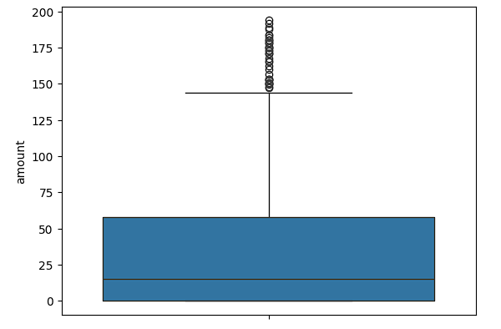
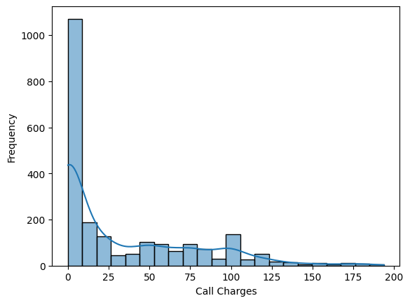
Analysis on Amount
Conditions:
callStatus should be Not Null as the value will only be recorded if it is a call
This shouldn’t be a free call as the amount will always be zero for such
Outliners are not being considered here as The distribution of the "amount" variable appears to be heavily skewed, with a significant number of observations having values close to 0, but with some very high values as well (up to 1800).
Analysis:
Count: There are now 2223 observations in the dataset after removing outliers.
Mean: The average value of the "amount" variable is approximately 32.55.
Standard Deviation (std): The standard deviation is about 42.33, indicating the spread or variability in the values of "amount" around the mean.
Min: The minimum value of "amount" in the dataset is 0.
25%: This is the first quartile, or the 25th percentile. It indicates that 25% of the observations have an "amount" value of 0 or less.
50%: This is the median, or the middle value of the dataset when it is ordered from least to greatest. In this case, it's 15, suggesting that half of the observations have an "amount" value of 15 or less.
75%: This is the third quartile, or the 75th percentile. It indicates that 75% of the observations have an "amount" value of 57.93 or less.
Max: The maximum value of "amount" in the dataset is 193.8.
We can see that peak frequencies are between (0-25) amount and as the amount increases the frquency also decreases. Which means customers are not inclined to pay higher amounts.

Slide 9
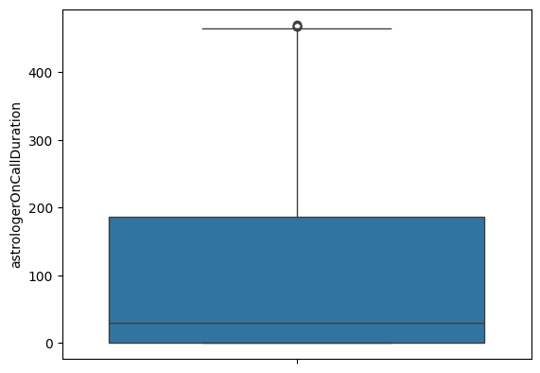
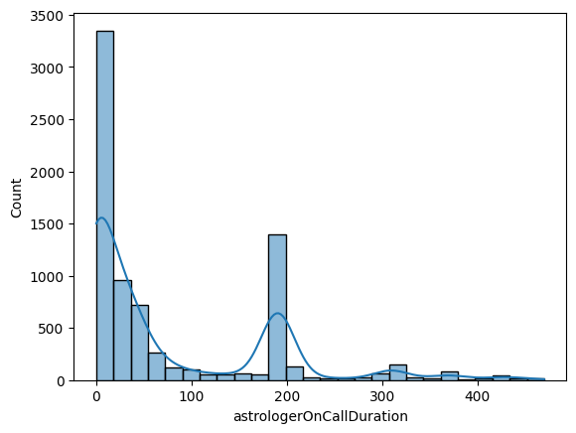
Analysis of Duration of Astrologer Call
Conditions:
The data appears to be right-skewed, with the mean (128.79) being greater than the median (34). This indicates that there are a few high-value outliers pulling the mean upwards. A significant proportion of the dataset consists of zeros, as both the 25th percentile and the minimum value are 0. The large standard deviation compared to the mean indicates high variability within the dataset, suggesting diverse values.
Analysis:
Count: There are 7792 observations in the dataset.
Mean: The average value of the "astrologerOnCallDuration" variable is approximately 77.17.
Standard Deviation (std): The standard deviation is about 101.56, indicating a considerable spread or variability in the values of "astrologerOnCallDuration" around the mean.
Min: The minimum value of "astrologerOnCallDuration" in the dataset is 0.
25%: This is the first quartile, or the 25th percentile. It indicates that 25% of the observations have an "astrologerOnCallDuration" value of 0 or less.
50%: This is the median, or the middle value of the dataset when it is ordered from least to greatest. In this case, it's 30, suggesting that half of the observations have an "astrologerOnCallDuration" value of 30 or less.
75%: This is the third quartile, or the 75th percentile. It indicates that 75% of the observations have an "astrologerOnCallDuration" value of 186 or less.
Max: The maximum value of "astrologerOnCallDuration" in the dataset is 470.
User Engagement:
The high frequency of short-duration calls (0-100 seconds) suggests that users might be seeking quick advice or answers.
Strategies to increase engagement might focus on encouraging longer consultations.
Service Structure:
The secondary spike around 200 seconds could indicate a typical session length that astrologers or users find optimal.
Understanding the reason for this spike can help in structuring services or pricing models around common call durations.
Training and Efficiency:
Astrologers may need training to improve efficiency in handling calls to provide value quickly, as many calls are very short.
Additionally, exploring why some calls extend to around 200 seconds might reveal opportunities to standardize call handling for better customer satisfaction.

Slide 10
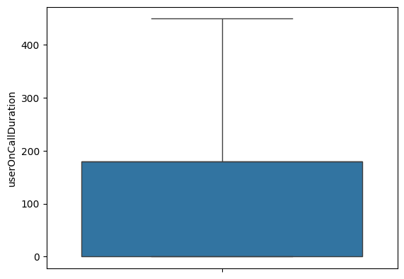
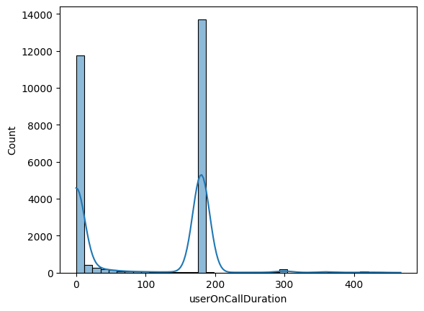
Analysis of Duration of Call by Users
Conditions:
Removing the outliner as The 50th and 75th percentiles being the same (180) suggests a clustering of values at 180. This indicates a large portion of the data points are exactly 180, which might be due to a common cutoff or a default value. A significant number of entries are zeros, as both the minimum and 25th percentile are 0. The large standard deviation compared to the mean indicates high variability within the dataset. The maximum value of 4020 suggests the presence of outliers or significantly high values in the dataset.
Analysis:
Count: There are 27446 observations in the dataset.
Mean: The average value of the "userOnCallDuration" variable is approximately 98.99.
Standard Deviation (std): The standard deviation is about 93.14, indicating a moderate spread or variability in the values of "userOnCallDuration" around the mean.
Min: The minimum value of "userOnCallDuration" in the dataset is 0.
25%: This is the first quartile, or the 25th percentile. It indicates that 25% of the observations have a "userOnCallDuration" value of 0 or less.
50%: This is the median, or the middle value of the dataset when it is ordered from least to greatest. In this case, it's 180, suggesting that half of the observations have a "userOnCallDuration" value of 180 or less.
75%: This is the third quartile, or the 75th percentile. It also indicates that 75% of the observations have a "userOnCallDuration" value of 180 or less.
Max: The maximum value of "userOnCallDuration" in the dataset is 449.
Overall, the histogram suggests that there are two main clusters of call durations: very short durations (likely missed or immediately terminated calls) and longer durations around the (180-200) seconds range. The majority of calls fall within these two clusters, with very few calls having durations between 100 and 180 seconds.

Slide 11
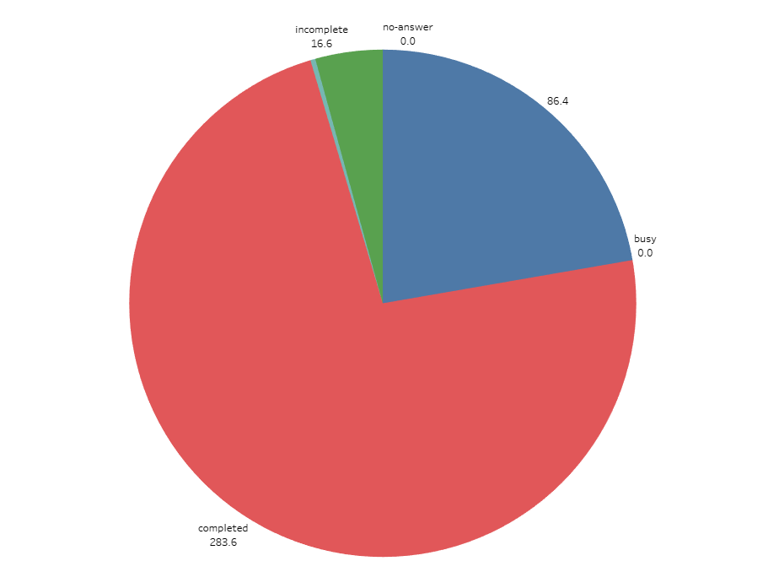
Analysis of Average Time Duration in Seconds by Call Status
Busy and No-answer:
Both statuses have an average duration of 0.00 seconds.
This indicates that these calls were not connected at all, possibly due to immediate disconnections or the calls not being picked up.
Completed:
The average duration for completed calls is significantly higher at 283.61 seconds.
This suggests that completed calls tend to be the longest, as they involve full conversations or consultations.
Failed:
The average duration for failed calls is 1.22 seconds.
This indicates that these calls were connected briefly but were unable to be completed, possibly due to technical issues or immediate hang-ups.
Incomplete:
The average duration for incomplete calls is 16.65 seconds.
These calls are longer than failed calls but significantly shorter than completed calls, indicating that the connection was made, but the call did not proceed to a full conversation.
Service Efficiency:
The high average duration for completed calls (283.61 seconds) implies that when calls are successful, they provide substantial interaction time, which could be beneficial for service quality.
Short durations for failed and incomplete calls suggest areas where service improvements could reduce the number of such occurrences.
Technical and Operational Issues:
The presence of 0.00-second durations for busy and no-answer calls indicates potential areas for improvement in call connection rates and handling.
User Experience:
Understanding the reasons behind failed and incomplete calls can help improve user experience by addressing technical issues and enhancing connection reliability.

Slide 12
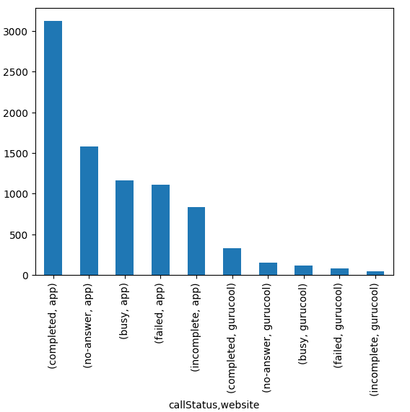
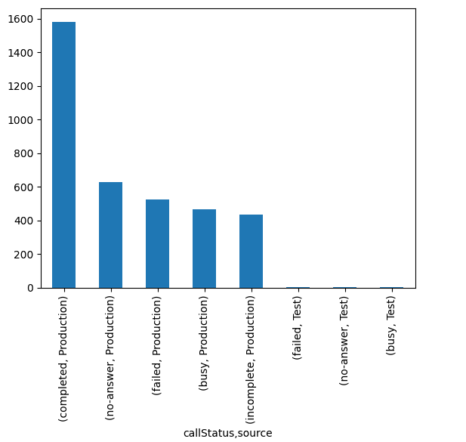
The most common source of calls
Insights:
The 'app' platform handles a much higher volume of calls but also experiences more issues with calls not being completed successfully.
The 'gurucool' platform, while handling fewer calls, appears to have a relatively better completion rate and fewer issues with no-answer, busy, failed, and incomplete calls.
Service Quality in Production:
The high number of completed calls in Production (1582) suggests that the majority of calls are successfully connected and completed.
However, the presence of a significant number of no-answer, failed, busy, and incomplete calls indicates areas for improvement in call handling and connection reliability.
Testing Phase:
The Test source shows very few calls overall, with no completed or incomplete calls recorded.
The presence of failed, no-answer, and busy calls in the Test source suggests issues that might need addressing before scaling or deploying to Production.

Slide 13
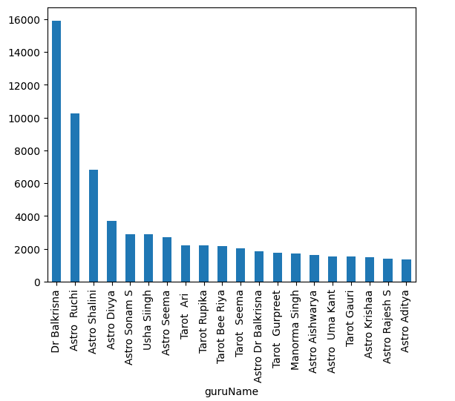
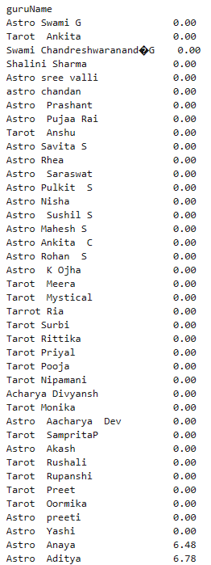
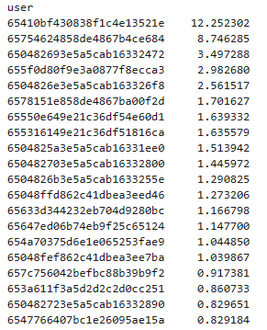
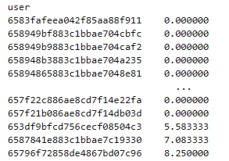
Gurus and Users Earning and Spendings
This is the bar graph showing the highest earners among Gurus. Dr Balkrisna earned around 16% of total earnings and Astro Ruchi earned around 10.36% of total earnings.
In the given time period, some users spend quite high amounts, such as around 12.25% of the total amount spent by all users, and then another user spends 8.75% of the total amount spent.
After further filtering, among users who chose paid call/chat, 8030 users haven't spent any money.
This is the list of Guru Names which have earned lowest and among them 38 haven't earned anything

Slide 14
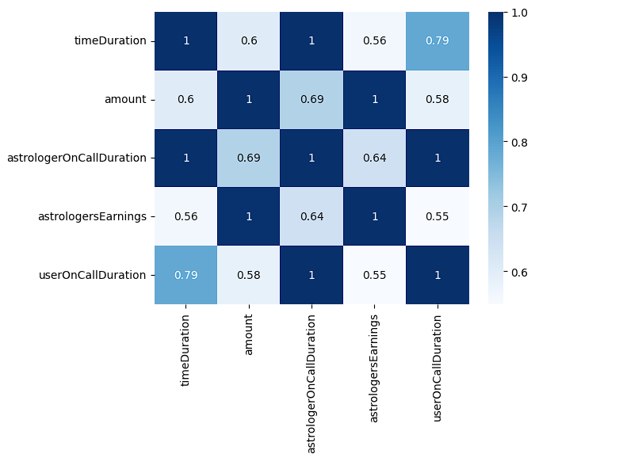
Analyzing Relationship between Talktime and Charge
Strongest Relationships:
astrologerOnCallDuration and userOnCallDuration (0.998971): These durations are almost perfectly correlated, indicating they tend to increase and decrease together.
amount and astrologersEarnings (0.995047): A very strong correlation, implying that the amount spent by users is almost directly reflected in astrologers' earnings.
timeDuration and astrologerOnCallDuration (0.998971): These two variables are almost perfectly correlated.
Moderate Relationships:
timeDuration and amount (0.602448): Indicates a tendency for higher timeDuration to be associated with higher amounts.
timeDuration and astrologersEarnings (0.561469): Shows a moderate positive association.
userOnCallDuration with timeDuration (0.785163) and astrologerOnCallDuration (0.998971): Indicates that userOnCallDuration is strongly related to both timeDuration and astrologerOnCallDuration.
Weaker but Notable Relationships:
userOnCallDuration and amount (0.584393): Moderate positive correlation.
astrologersEarnings and userOnCallDuration (0.548681): Moderate positive correlation.

Slide 15
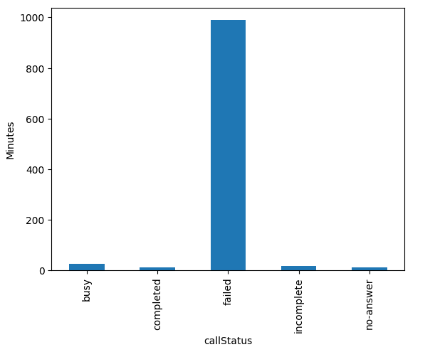
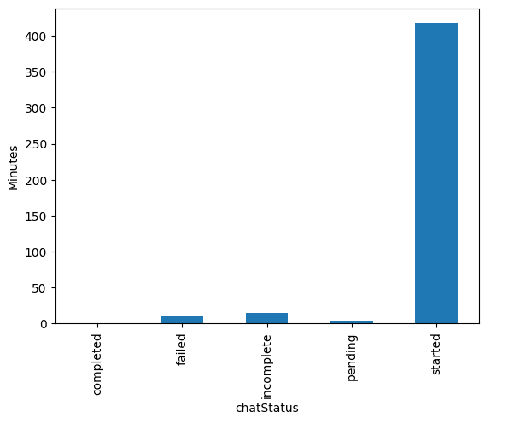
Average time for calls to be connected
The average difference in time between createdAt and chatStarttime varies significantly across different call statuses, indicating varying levels of efficiency and effectiveness in initiating these calls.
Identifying and addressing the factors contributing to delays in initiating calls, especially for failed calls with exceptionally high average differences, can help improve operational efficiency and user experience.
Response Time:
Completed chats have the shortest average difference, indicating a quick response time.
Failed and incomplete chats have considerably longer average differences, suggesting delays or issues in starting these chats.
User Experience:
Long delays, as seen in started chats, can significantly impact user experience and satisfaction.
Short response times, as seen in completed chats, contribute to a positive user experience.

Slide 16
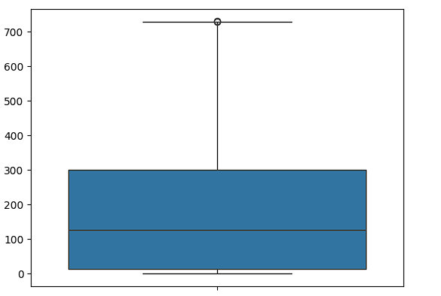
Common Reason for call Disconnection
Mean: The mean time difference is approximately 152.86 seconds. This indicates that, on average, chats last for around 2 minutes and 32.86 seconds.
Standard Deviation: The standard deviation is relatively high at approximately 139.15 seconds. This suggests a notable variability or dispersion in the duration of chats around the mean.
Minimum: The minimum time difference is approximately 0.011833 seconds. This suggests that some chats end almost immediately after they start, possibly indicating quick resolutions or interruptions.
25th Percentile (Q1): 25% of the chats have a time difference of 14.696 seconds or less. This indicates that a quarter of the chats are relatively short in duration.
Median (50th Percentile, Q2): The median time difference is approximately 126.38 seconds. This suggests that half of the chats have a duration of 2 minutes and 6.38 seconds or less.
75th Percentile (Q3): 75% of the chats have a time difference of 300.574 seconds or less. This indicates that most chats are relatively short, with only a quarter having longer durations.
Maximum: The maximum time difference is 730.735 seconds, which is approximately 12 minutes and 10.735 seconds. This represents the longest duration observed in the dataset.
Trends and Patterns:
Short Chats: There is a significant proportion of short chats, as indicated by the low values in the 25th percentile and below.
Variability: The relatively high standard deviation suggests that there is considerable variability in chat durations.
Common Duration: The median duration of 2 minutes and 6.38 seconds suggests that this is a common duration for chats.
Longer Chats: While most chats are relatively short, there are also some longer chats, as indicated by the maximum value.

Slide 17
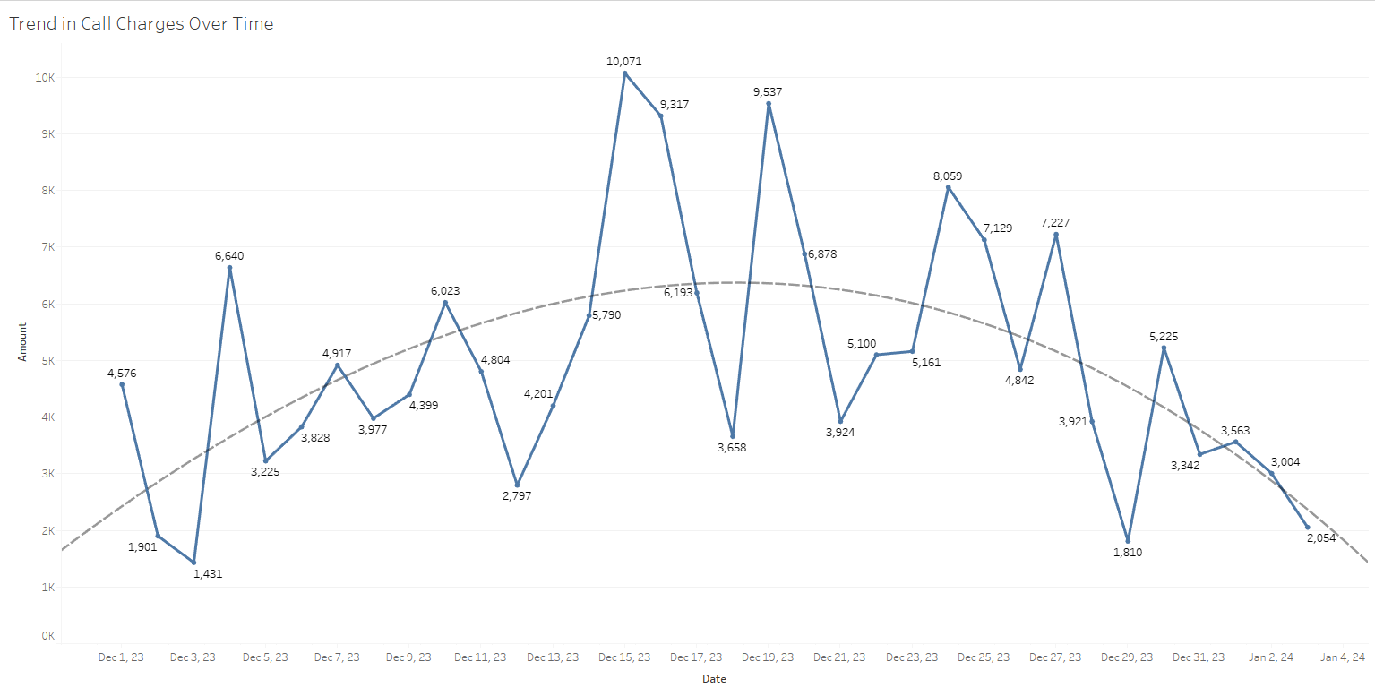
It appears the call charges fluctuate over time, but there is no clear upward or downward trend. There are some spikes in the data, with the highest charge being around 10,000 on December 21st, 2023
By the polynomial trend line, we can see a curve being drawn, we can simply understand that revenue started to pick from Dec 13th till Dec 24th. Most probably due to beginning of holiday season.

Slide 18
Overall Insight:
Correlations and Feature Engineering:
Some variables may be redundant due to high correlations.
Outliers in amount and earnings should be investigated.
Consider creating new features to capture important relationships.
Non-Numerical Column Analysis:
Unique identifiers ensure data integrity.
"Failed" chats are common, and most transactions are non-refundable.
Certain gurus and consultation types are more popular.
Analysis on Amount: After outlier removal, average spending is around 32.55.
Call Duration Analysis: Most calls have short durations, with strong correlations between astrologer and user durations.
Average Talk Time of Different Call Activities: Completed calls have the highest average talk time.
Common Source of Calls: The 'app' platform is commonly used but faces more completion issues.
Total Earnings and Spendings: Some users haven't spent any money, and certain gurus earn significantly more.
Relationship between Talk Time and Amount: Higher talk times tend to correlate with higher spending.
Average Time for Calls to Connect: Median values suggest quick chat initiation, longer for calls.
Average Time Difference by Call/Chat Status: Failed calls have the longest average delay, completed chats have the shortest.
Reasons for Call Disconnection: Most chats are short, common duration around 2 minutes.
Refund Analysis: Refunds are rare, with a minimal total refund amount.

Slide 19
Actionable Recommendations:
Streamline Platform Usage:
Analyze user preferences and behaviors to optimize the platform for better user experience, especially focusing on reducing completion issues on the 'app' platform.
Offer incentives or promotions to encourage users to complete their chats successfully, especially targeting users experiencing failed or incomplete chats.
Refund Policy Review:
Since almost all transactions are non-refundable, ensure transparency in refund policies and communicate them clearly to users.
Consider implementing a flexible refund policy for exceptional cases to enhance customer satisfaction and trust.
Feature Engineering for Efficiency: Utilize feature engineering techniques to create new variables capturing important relationships, such as average earnings per unit time, to improve efficiency in earnings analysis and resource allocation.
Optimize Call Initiation Process: Focus on reducing the average time for calls to connect, especially for failed and incomplete calls, by addressing technical glitches, improving network infrastructure, and optimizing call handling procedures.
Enhance User Engagement: Offer personalized recommendations or incentives to encourage users to spend more time on the platform, leading to longer call durations and potentially higher spending. Implement features that improve chat initiation times, ensuring quick responses to user queries or requests.
Guru Performance Management:
Provide additional support or training to less active gurus to increase their engagement and earnings.
Recognize and incentivize top-performing gurus to maintain their motivation and commitment to the platform.

Slide 20
Actionable Recommendations:
Data Quality Assurance:
Continuously monitor and validate data quality, especially concerning outliers and irregularities, to ensure accurate analysis and decision-making.
Implement data cleansing and preprocessing techniques to address data inconsistencies and improve the reliability of insights derived from the dataset.
Marketing and Promotion Strategies:
Leverage insights on user spending patterns and preferences to tailor marketing campaigns and promotions effectively, driving user acquisition and retention.
Highlight platform strengths, such as quick chat initiation times or high completion rates, in marketing materials to attract new users and build trust.
Customer Feedback Utilization:
Actively gather and analyze customer feedback to identify areas for improvement and address pain points effectively.
Implement changes based on customer feedback to enhance overall customer satisfaction and loyalty.
Competitive Analysis:
Conduct a competitive analysis to benchmark platform performance against industry standards and identify areas where the platform can differentiate itself and gain a competitive advantage.
Learn from competitors' successes and failures to refine business strategies and tactics accordingly.

